Slide 1

Project Title
Merchandise Sales Analysis using Power BI

Slide 2
Introduction
Project Objective
To analyze business performance using interactive dashboards
Provide decision-makers with real-time insights
Identify sales, profit, and customer trends for better strategy
Why Power BI?
User-friendly drag-and-drop dashboard creation
Integration with multiple data sources (Excel, SQL, APIs, etc.)
Interactive visualizations for better storytelling
Real-time updates for business intelligence
Cost-effective compared to other BI tools

Slide 3
Problem Statement / Business Question
Problem Statement
Businesses generate large amounts of data but struggle to:
Track sales and profit trends effectively
Identify top-performing products, categories, or regions
Understand customer behavior for decision-making
Convert raw data into clear and actionable insights
Business Questions
What are the overall sales and profit trends over time?
Which products or categories contribute the most revenue?
Who are the top customers driving business growth?
Which regions/markets perform best?
How can insights from data improve future strategies?

Slide 4
Data Source & Preparation
Dataset Details
Data Type: Sales / Finance dataset
Key Fields:
Order Date, Ship Date
Product Category, Sub-Category
Customer Segment, Region
Sales, Quantity, Discount, Profit
Data Sources: Excel / CSV / SQL Database (replace with your actual source)
Data Cleaning & Transformation Steps
Removed duplicates and invalid entries
Handled missing values (null sales, blank categories)
Standardized formats (dates, currency, text fields)
Created calculated fields (Total Sales = Quantity × Price)
Data modeling – relationships between tables (Sales ↔ Customers ↔ Products)
Loaded into Power BI for visualization

Slide 5
Dashboard Overview
Main Dashboard Features
Interactive visuals for sales, profit, and customer insights
KPIs displayed at the top (Total Sales, Profit, Quantity, etc.)
Filters & slicers for Year, Region, Category, Segment
Dynamic charts:
Sales Trend (Line Chart)
Profit by Category (Bar Chart)
Sales by Region (Map / Donut Chart)
Top Customers (Table / Bar Chart)

Slide 6
Key Performance Indicators
Highlighted KPIs
Total Sales – Overall revenue generated
Total Profit – Net earnings after discounts
Quantity Sold – Total units sold across categories
Average Discount % – Impact of discounts on sales & profit
Top Region / Category – Best performing segment

Slide 7
Sales/Profit Analysis
Yearly / Monthly Trends
Sales Growth: Steady increase year-over-year
Profit Trends: Seasonal fluctuations observed
Monthly View: Peaks during holiday/festival seasons
Top Performing Categories / Segments
Technology – Highest revenue contribution
Furniture – Moderate sales but lower profit margins
Office Supplies – Stable sales with consistent growth
Customer Segments: Corporate segment contributes the most profit

Slide 8
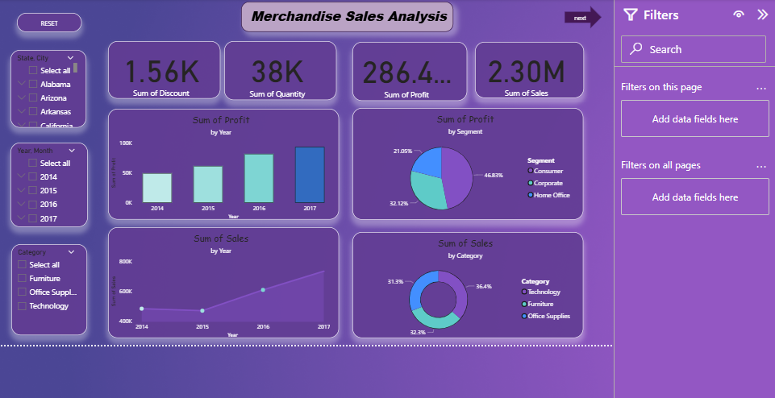
PAGE 1

Slide 9
Customer & Category Insights
Customer Demographics
Top Customers contribute a significant share of total revenue
Corporate segment = highest profit contributor
Consumer segment = largest volume of orders
Category Analysis
Technology – Highest sales & profit growth
Furniture – Lower margins despite good sales
Office Supplies – Consistent performer, stable demand
Regional Trends
West & East regions = strongest in sales performance
South region = steady but lower contribution
Central region = underperforming, needs focus

Slide 10
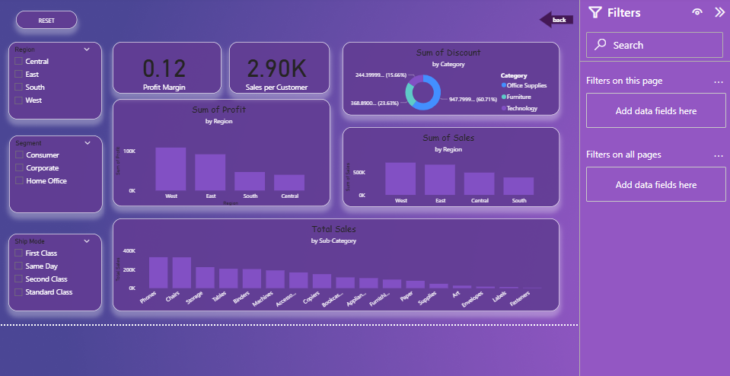
PAGE 2

Slide 11
Conclusion & Insights
Major Findings
Sales & Profit Growth: Overall upward trend, with seasonal peaks
Top Category: Technology contributes the highest revenue & profit
Customer Segments: Corporate customers drive profitability, while Consumers generate volume
Regional Trends: West & East regions outperform others; Central needs improvement
Recommendations
Focus on Technology Category → Expand product range to maximize growth
Improve Furniture Margins → Revisit pricing & discount strategy
Target Underperforming Regions → Marketing campaigns for Central region
Strengthen Customer Retention → Loyalty programs for top customers
Leverage Power BI Dashboards → Regular monitoring for real-time decision making

Slide 12
Future Scope
Enhancements for the Dashboard
AI & Predictive Analytics
Forecast future sales and profit trends
Use machine learning models for demand prediction
Automation
Schedule automatic data refreshes
Set up real-time alerts for KPI thresholds
Advanced Visualization
Add drill-through reports for deeper insights
Use custom visuals for better storytelling
Integration
Connect with CRM & ERP systems for holistic analysis
Embed dashboards in business apps (Teams, SharePoint, etc.)
Scalability
Expand to cover additional business areas (HR, Finance, Supply Chain)

